Slide 1
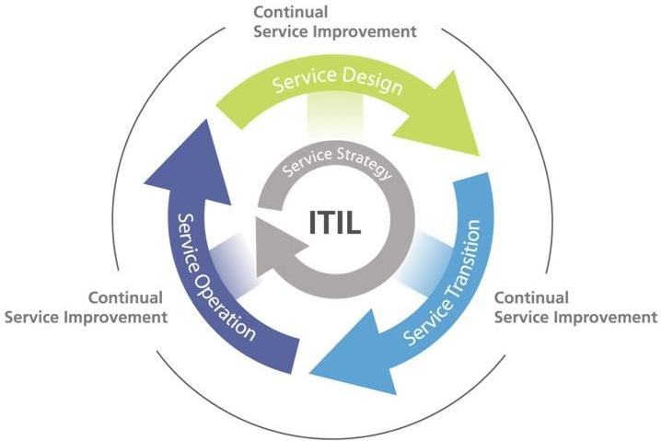
Introduction to ITIL V3
October 22nd 2013
Ron Young – Sr. Infrastructure Strategist

Slide 2
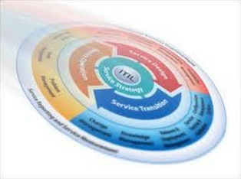

Introduction to ITIL V3
Tonight’s Objectives
Provide a High level overview of ITIL V3
Give insights into the possible benefits from using ITIL V3
Provide some “real world” examples of ITIL being applied
Provide information on where to get more information if your interested in ITIL
Answer your ITIL questions
Have some fun

Slide 3

Introduction to ITIL V3
Audience Baseline
By a Show of Hands….
Have you ever heard of ITIL?
Have you used ITIL?
Are you certified in ITIL Foundations?
Do you have any higher level ITIL Management Certifications?

Slide 4
Introduction to ITIL V3
Presentation Overview
Provide an Introduction to ITIL V3
A Brief History of ITIL
A high level look at each of the five core components of ITIL
We will compare and contrast good service mgmt vs. bad service mgmt practices
Compare ITIL to other IT management frameworks
Provide an overview of the Advantages and Disadvantages of using ITIL
Where to get more information on ITIL
Answer any Questions you have…….

Slide 5

Introduction to ITIL V3
Biography of Ron Young
Over 25 years experience delivering IT solutions
More than 15 years of IT Service Management experience
Currently on the Board of Directors for itSMF – Great Lakes Local Interest Group (GLLIG)
Obtained the ITIL V3 “Service Management Expert” certificate in 2008
ITIL Foundation and ITIL V2 Service Manager certifications in in 2003
Bachelor of Science Degree in Mechanical Engineering from SIU – Carbondale.
Contact Information:
Ron.Young@t-systems.com
616-456-7263 home office
http://www.linkedin.com/in/ronaldyoung

Slide 6
Introduction to ITIL V3
T-Systems Overview
IT Services Division of Deutsche Telekom
Sister Company to T-Mobile
Offices in 28 countries
Over 51,000 T-Systems employees
Over 130 Datacenters managed
Over 300,000 KM of Optical Network Cable managed
10+ Billion Euro Total Revenue in 2012
Manage over 1.2 Million SAP Users.
Comprehensive Portfolio of Private Cloud Services
Key Customers: Shell Oil, BP, DHL, Daimler, VW, Heineken, ALDI, T-Mobile

Slide 7
Introduction to ITIL V3
IT Service Management Definitions
A service is a means of delivering value to customers by facilitating outcomes customers want to achieve without the ownership of specific costs and risks.
IT Service Management - The professional practice of planning, designing, developing, delivering and optimizing IT services that are both fit for purpose and fit for use, thereby providing best value and return on investment for the organization that uses them.
ITsmf USA is a non-profit association dedicated to building a community of professionals for the purpose of networking, knowledge sharing, and education to advance the service management profession and strengthen our members.
Itsmf USA Membership Brochure:
Source: 2011 English Glossary V1.0 & www.itsmfusa.org

Slide 8
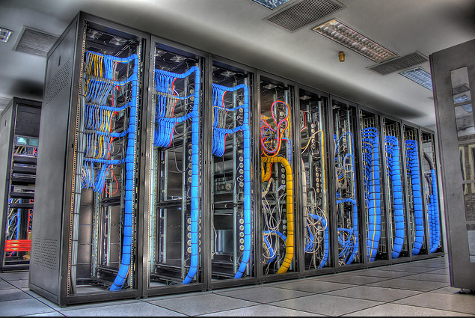
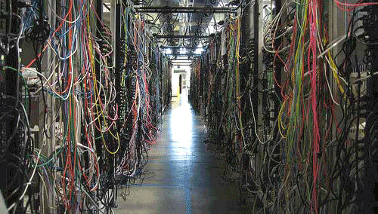
Introduction to ITIL V3
Good Datacenter Mgmt vs. Bad Datacenter Mgmt
vs.
When you look at a datacenter it is pretty easy determine whether you are looking at good management practices vs. bad management practices
But how can you tell the difference between good service management and bad service management?
One of the main objectives tonight is to compare and contrast good ITSM vs. bad ITSM.

Slide 9

Introduction to ITIL V3
What is ITIL?
The Information Technology Infrastructure Library (ITIL) is a public framework of “Best” practices for IT service management (ITSM) that focuses on aligning IT services with the needs of the business. ITIL is the most widely adopted framework for IT Service Management in the world. It is a practical, no-nonsense approach to the identification, planning, delivery and support of IT services to the business.
In its current form (known as ITIL 2011 edition), ITIL is published in a series of five core publications, each of which covers an ITSM lifecycle stage. ITIL underpins ISO/IEC 20000(previously BS15000), the International Service Management Standard for IT service management
Source: http://www.itil-officialsite.com

Slide 10
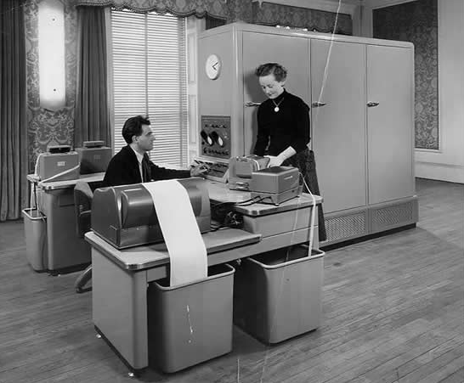
Introduction to ITIL V3
A Brief History of ITIL
In the late 1970’s the UK government was tired of failed IT projects, so they tasked the UK University community to determine a better way.
ITIL V1 was used between 1989 and 2000 and consisted of 31 books
ITIL V2 was used between 2000 and 2007 and consisted of 7 books
ITIL V3 was used between 2007 and 2011 and consisted of 5 core books
ITIL 2011 edition is a slight revision of the 2007 edition.
Source: www.wikipedia.com

Slide 11
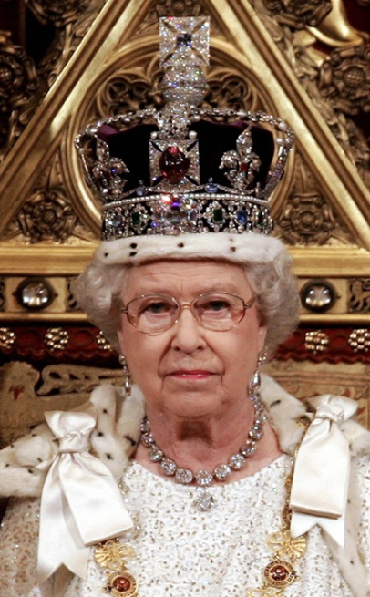
Introduction to ITIL V3
Who owns ITIL?
The Short Answer is the OGC or the “Crown” which is essentially the UK Government.
The APM Group has delegated authority to issue Trade Mark Licenses for the re-use of the Cabinet Office's Trade Marks.
APM Group also has the authority to issue Trade Mark and Crown copyright licenses to those who wish to reproduce content from official publications produced by the Cabinet Office relating to those trademarks.
The rules and permissions around the use of Intellectual Property subsisting in ITIL are varied, depending on the user, so for full and detailed information, please see:
http://www.itil-officialsite.com/IntellectualPropertyRights/IntellectualPropertyRights.aspx
Source: http://www.itil-officialsite.com

Slide 12
Introduction to ITIL V3
Why do Organizations use ITIL?
The overall IT Service Delivery Landscape (services, processes and technology) will become more standardized, which allows any number of IT service providers to communicate in a manner which allows them to work together to seamlessly manage the entire IT landscape.
If done properly, this can lead to:
- increased user and customer satisfaction with IT services
- improved service availability, directly leading to increased business profits and revenue
- financial savings from reduced rework, lost time, improved resource management and usage , companies have reported cost savings for IT support over 75%
- improved time to market for new products and services
- improved decision making and optimized risk.
Source: OGC Executive Briefing Benefits of ITIL

Slide 13
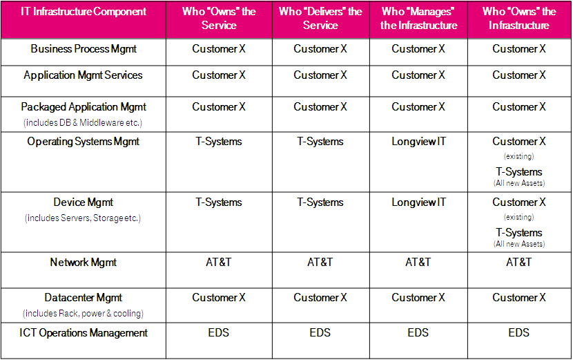
Introduction to ITIL V3
Example of a Service Delivery Landscape

Slide 14
Introduction to ITIL V3
An Excellent ITIL Overview
IT Silos vs. IT Services:
http://www.youtube.com/watch?v=vBguassbAzo
Source: Compucom

Slide 15
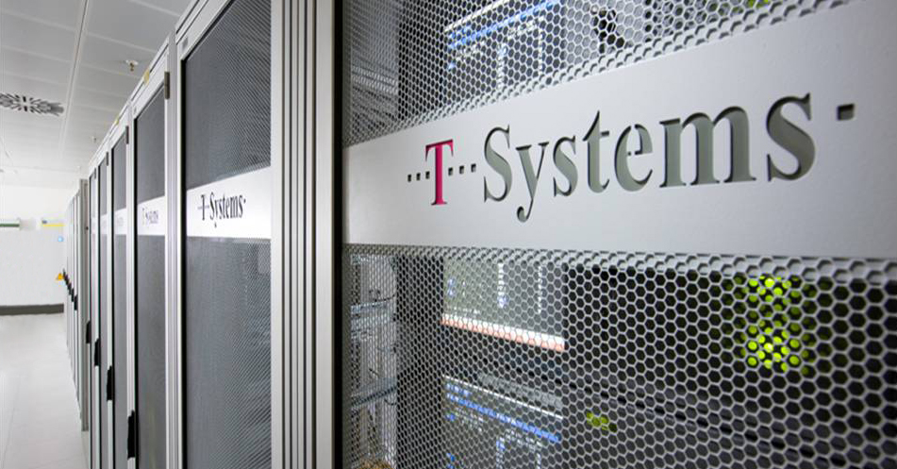
ITIL Core Components
Slide 15

Slide 16
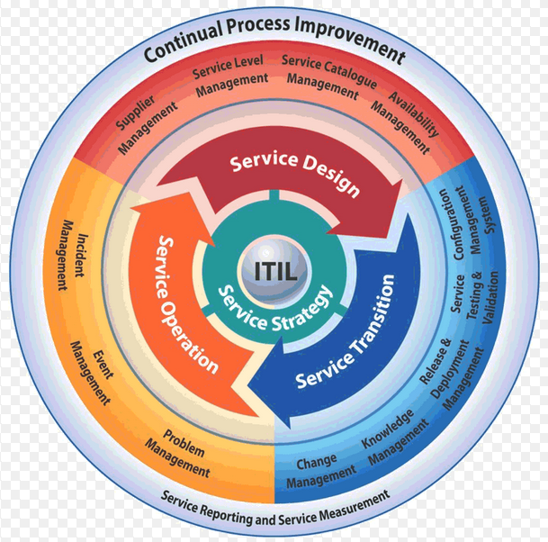
Intro to ITIL V3
Graphical Process Model
Source: http://www.itil-officialsite.com

Slide 17
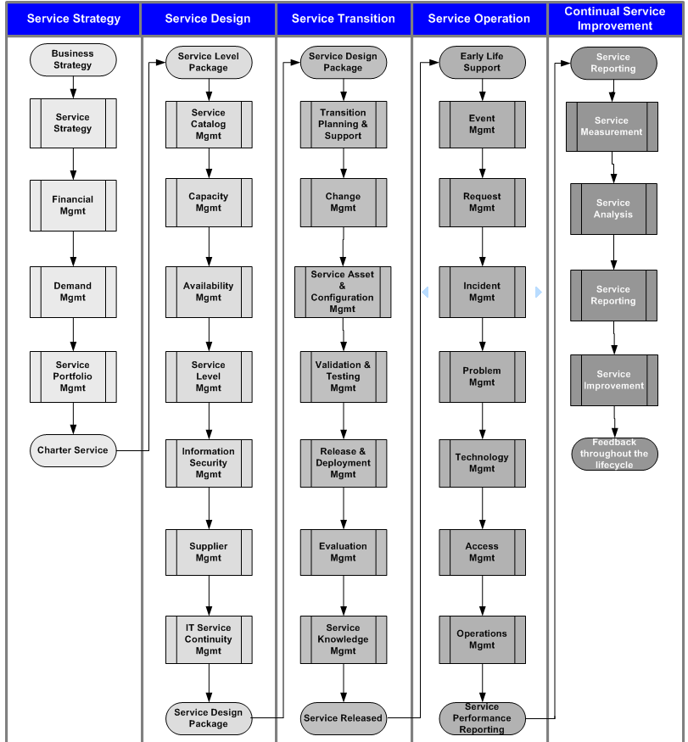
Intro to ITIL V3
Process Model
Source: The Official Introduction to the ITIL Service Lifecycle

Slide 18
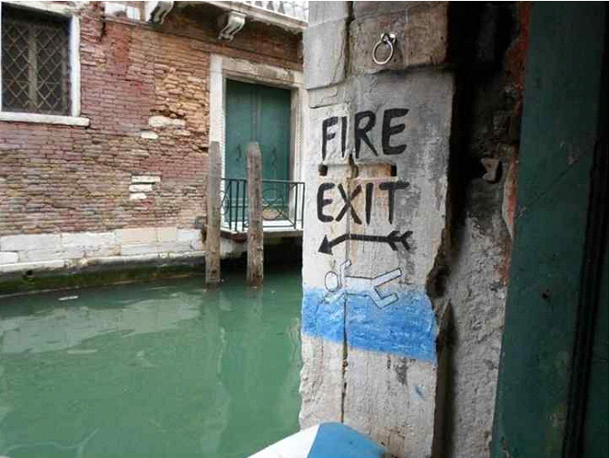
Introduction to ITIL V3
Tired of fighting Fires?

Slide 19
Introduction to ITIL V3
ITIL Service Strategy Swim Lane
Service strategy defines the perspective, position, plans and patterns that a service provider needs to execute to meet an organization’s business outcomes. Service strategy includes defining and documenting the requirements for the IT services strategy to align with the defined Business Strategy.
Financial Management is the function and processes responsible for managing an IT service provider’s budgeting, accounting and charging requirements. Financial management for IT services secures an appropriate level of funding to design, develop and deliver services that meet the strategy of the organization in a cost-effective manner.
Demand Management is the process responsible for understanding, anticipating and influencing customer demand for services. Demand management works with capacity management to ensure that the service provider has sufficient capacity to meet the required demand. At a strategic level, demand management can involve analysis of patterns of business activity and user profiles, while at a tactical level, it can involve the use of differential charging to encourage customers to use IT services at less busy times, or require short term activities to respond to unexpected demand or the failure of a configuration item.
Service Portfolio Management is the process responsible for managing the service portfolio. Service portfolio management ensures that the service provider has the right mix of services to meet required business outcomes at an appropriate level of investment. Service portfolio management considers services in terms of the business value that they provide.
Output = Charter Service
Source: 2011 English Glossary V1.0

Slide 20
Introduction to ITIL V3
Good Service Mgmt vs. Poor Service Mgmt
Indicators of Good IT service management
Alignment between IT and the business:
A close relationship between the IT service provider and business customers at all levels, which feels like a trusted partnership
A clear service catalog explaining the services available and what business purposes they serve
IT services focus on the priorities and needs of the business
IT staff understand the importance of IT services, the value the business gets from each service and they react to requests, incidents and problems in a way that reflects this value.
Indicators of poor IT service management
Misalignment between IT and the business:
It is unclear what IT services exist and what business purposes they serve
There is no service catalog
IT priorities are not in line with business needs and priorities
Urgent business needs are not responded to in a timely manner
IT services seem focused on technology rather than business priorities.
This indicates poor service strategy practice.
Source: OGC Executive Briefing Benefits of ITIL

Slide 21
Introduction to ITIL V3
ITIL Service Design Swim Lane
Service Catalog Management is a database or structured document with information about all active IT services, including those available for deployment. The service catalog is part of the service portfolio and contains information about two types of IT service: customer-facing services that are visible to the business; and supporting services required by the service provider to deliver customer-facing services.
Availability Management is the process responsible for ensuring that IT services meet the current and future availability needs of the business in a cost-effective and timely manner. Availability management defines, analyses, plans, measures and improves all aspects of the availability of IT services, and ensures that all IT infrastructures, processes, tools, roles etc. are appropriate for the agreed service level targets for availability.
Service Level Management is the process responsible for negotiating achievable service level agreements and ensuring that these are met. It is responsible for ensuring that all IT service management processes, operational level agreements and underpinning contracts are appropriate for the agreed service level targets. Service level management monitors and reports on service levels, holds regular service reviews with customers, and identifies required improvements.
Information Security Management is the process responsible for ensuring that the confidentiality, integrity and availability of an organization’s assets, information, data and IT services match the agreed needs of the business. Information security management supports business security and has a wider scope than that of the IT service provider, and includes handling of paper, building access, phone calls etc. for the entire organization.
Source: 2011 English Glossary V1.0

Slide 22
Introduction to ITIL V3
ITIL Service Design Swim Lane
Supplier Management is the process responsible for obtaining value for money from suppliers, ensuring that all contracts and agreements with suppliers support the needs of the business, and that all suppliers meet their contractual commitments.
IT Service Continuity Management is the process responsible for managing risks that could seriously affect IT services. IT service continuity management ensures that the IT service provider can always provide minimum agreed service levels, by reducing the risk to an acceptable level and planning for the recovery of IT services. IT service continuity management supports business continuity management.
Output = Service Design Package
Source: 2011 English Glossary V1.0

Slide 23
Introduction to ITIL V3
Good Service Mgmt vs. Poor Service Mgmt
Indicators of Good IT service management
Focus on both functionality and usability:
IT services are designed to work in operation, available when required, performing as expected.
Security threats are dealt with quickly and effectively
Unexpected incidents are resolved quickly and effectively, ensuring business users are involved in decisions and always kept informed.
A catalog of available IT services is written in terms the users understand, with prices (if users pay for IT services) or cost information (if not)
Third-party costs are known and controlled.
Capacity is monitored and any purchases to increase capacity are planned well in advance and budgeted.
Indicators of poor IT service management
Over-focus on functionality at the expense of usability:
Unexpected IT service outages are frequent
When problems occur it takes longer than expected to recover the situation
The IT services perform badly and sometimes run out of data or processing capacity.
There are additional unexpected charges from external suppliers and occasional contractual disputes.
IT issues are often blamed on third-party suppliers.
These aspects indicate poor design of the IT service.
Source: OGC Executive Briefing Benefits of ITIL

Slide 24
Introduction to ITIL V3
ITIL Service Transition Swim Lane
Transition Planning & Support is the process responsible for planning all service transition processes and coordinating the resources that they require.
Change Management is the process responsible for controlling the lifecycle of all changes, enabling beneficial changes to be made with minimum disruption to IT services.
Service Asset & Configuration Management is the process responsible for ensuring that the assets required to deliver services are properly controlled, and that accurate and reliable information about those assets is available when and where it is needed. This information includes details of how the assets have been configured and the relationships between assets.
Validation & Testing Management is the process responsible for validation and testing of a new or changed IT service. Service validation and testing ensures that the IT service matches its design specification and will meet the needs of the business.
Release & Deployment Management is the process responsible for planning, scheduling and controlling the build, test and deployment of releases, and for delivering new functionality required by the business while protecting the integrity of existing services.
Source: 2011 English Glossary V1.0

Slide 25
Introduction to ITIL V3
ITIL Service Transition Swim Lane
Evaluation Management is the process responsible for assessing a new or changed IT Service to ensure that risks have been managed and to help determine whether to proceed with the change. Evaluation is also used to mean comparing an actual outcome with the intended outcome, or comparing one alternative with another.
Service Knowledge Management is a set of tools and databases that is used to manage knowledge, information and data. The service knowledge management system includes the configuration management system, as well as other databases and information systems. The service knowledge management system includes tools for collecting, storing, managing, updating, analyzing and presenting all the knowledge, information and data that an IT service provider will need to manage the full lifecycle of IT services.
Output = A Released Service
Source: 2011 English Glossary V1.0

Slide 26
Introduction to ITIL V3
Good Service Mgmt vs. Poor Service Mgmt
Indicators of Good IT service management
Any shortfalls in service design and development are picked up during service transition, and the service is not accepted into operation until it is ready
Clearly communicated release schedules that identify the introduction of new and changed IT services
The risks and potential impacts of change are discussed with business users before the change takes place
Changes are agreed, well planned and implemented in a timely fashion with minimal disruption to the business.
Indicators of poor IT service management
The developers ‘handover’ the ‘service’ to operational staff in the expectation that it is ready, but the service initially fails to provide the expected benefits to the business.
Changes happen without users and support services being informed
New or changed IT services are fraught with problems, and often lead to unexpected issues with other services
Operational resources are distracted from day-to-day work by the problems caused by change.
This indicates poor service transition practice.
Source: OGC Executive Briefing Benefits of ITIL

Slide 27
Introduction to ITIL V3
ITIL Service Operations Swim Lane
Event Management is the process responsible for managing events throughout their lifecycle. Event management is one of the main activities of IT operations.
Request Management is the process responsible for managing the lifecycle of all service requests.
Incident Management is the process responsible for managing the lifecycle of all incidents. Incident management ensures that normal service operation is restored as quickly as possible and the business impact is minimized.
Problem Management is the process responsible for managing the lifecycle of all problems. Problem management proactively prevents incidents from happening and minimizes the impact of incidents that cannot be prevented.
Technology Management is the function responsible for providing technical skills in support of IT services and management of the IT infrastructure. Technical management defines the roles of support groups, as well as the tools, processes and procedures required.
Access Management is the process responsible for allowing users to make use of IT services, data or other assets. Access management helps to protect the confidentiality, integrity and availability of assets by ensuring that only authorized users are able to access or modify them. Access management implements the policies of information security management and is sometimes referred to as rights management or identity management.
Operations Management is the function within an IT service provider that performs the daily activities needed to manage IT services and the supporting IT infrastructure. IT operations management includes IT operations control and facilities management.
Source: 2011 English Glossary V1.0

Slide 28
Introduction to ITIL V3
Good Service Mgmt vs. Poor Service Mgmt
Indicators of Good IT service management
Incidents and problems under control:
Failures sometimes occur, but they are resolved effectively and users are kept informed
A proactive approach is taken to problem solving, anticipating and preventing problems wherever possible
Lessons are learned, problems are rarely repeated.
Users are confident that issues will be resolved before they adversely impact the business.
Indicators of poor IT service management
Too many incidents and problems:
There are many failures and IT service disruptions
IT support staff appear to be always ‘firefighting’ (reacting to problems and failures) and do not have time to make progress in other areas
The failures have a disruptive impact on business functions.
This indicates poor service operation practice.
Source: OGC Executive Briefing Benefits of ITIL

Slide 29
Introduction to ITIL V3
ITIL Service Management Rollout
Incident L2
Incident L3
Incident L4
IM (L3), CFM (L3) *
Problem L1
Problem L2
Problem L3
Problem L4
CFM (L3), CM (L3) *
Change L2
Change L3
Change L4
CFM (L3), RM(L3) *
Config L1
Config L2
Config L3
Config L4
PM (L3) RM(L3) *
Release L1
Release L2
Release L3
Maturity Level certified
* Process Interdependencies
Source: 2006 Fusion Conference Slides

Slide 30
Introduction to ITIL V3
ITIL Continual Service Improvement Swim Lane
Service Measurement is the process that is invoked by many other IT service management (ITSM) processes to measure specific availability or performance metrics. Service Measurement is necessary for the execution of other processes, and is executed by those processes throughout the service lifecycle.
Service Analysis are the activities and techniques used to review and identify issues with the with the performance, availability or capacity of an IT service.
Service Reporting are the activities that produce and deliver reports of achievement and trends against service levels. The format, content and frequency of reports should be agreed with the customers.
Service Improvement is the process of developing a formal plan to implement improvements to a process or IT service.
Source: 2011 English Glossary V1.0

Slide 31
Introduction to ITIL V3
Good Service Mgmt vs. Poor Service Mgmt
Indicators of Good IT service management
IT Services & Infrastructure are monitored continuously:
Service providers are concerned with customer perceptions and expectations.
Capacity & Availability issues are proactively resolved by evaluating trending data to predict when IT services will be negatively impacted.
Information required for auditing an IT environment is readily available to the auditors.
Benchmarking is part of the organizational culture, where they use benchmarks to regularly and consistently to compare the performance of their IT services to market competitors.
Businesses understand the customer satisfaction for every IT service and they are confident that their IT service provider is providing good value for money.
Indicators of poor IT service management
The cost and quality of IT services is not measurable:
The IT service delivery performance does not meet the expectations of the IT consumers and/or IT stakeholders.
‘Panic’ purchases of hardware and software, often occur which leads to inflated & unexpected costs.
Service providers use technical jargon to describe services and explain what is happening.
A Business Impact Analysis (BIA) has not been done recently.
IT Service Continuity Test plans or DR Plans are not current and are not tested regularly.
This indicates poor Continual Service Improvement.
Source: OGC Executive Briefing Benefits of ITIL

Slide 32
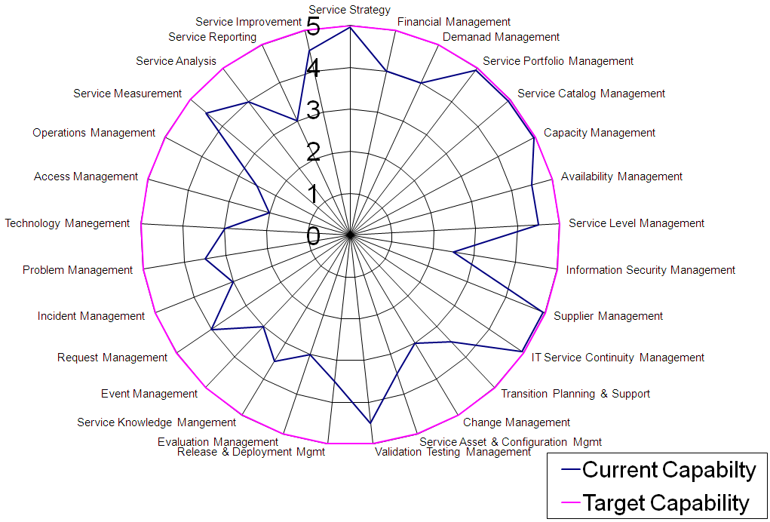
Introduction to ITIL V3
ITIL Maturity Spider Diagram

Slide 33

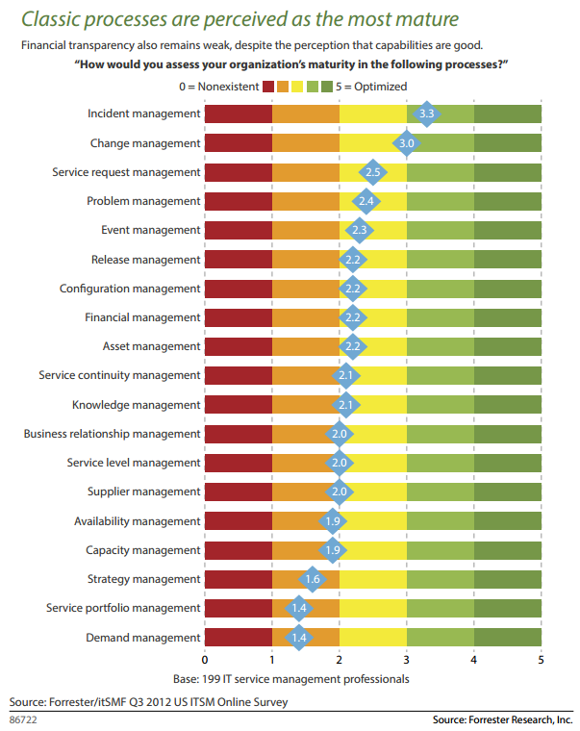
Introduction to ITIL V3
ITIL Maturity Status

Slide 34
Training
Slide 34

Slide 35
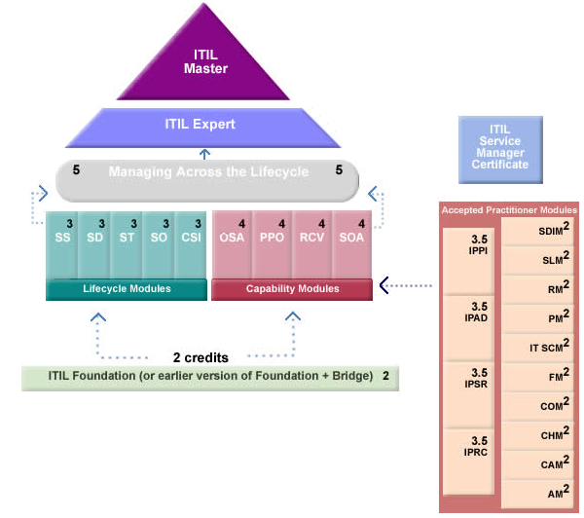
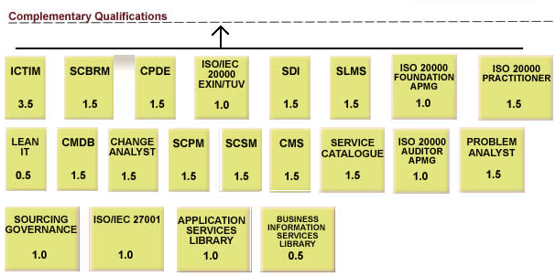
Introduction to ITIL V3
ITIL Certification Overview
Legend:
Source: http://www.itil-officialsite.com/

Slide 36
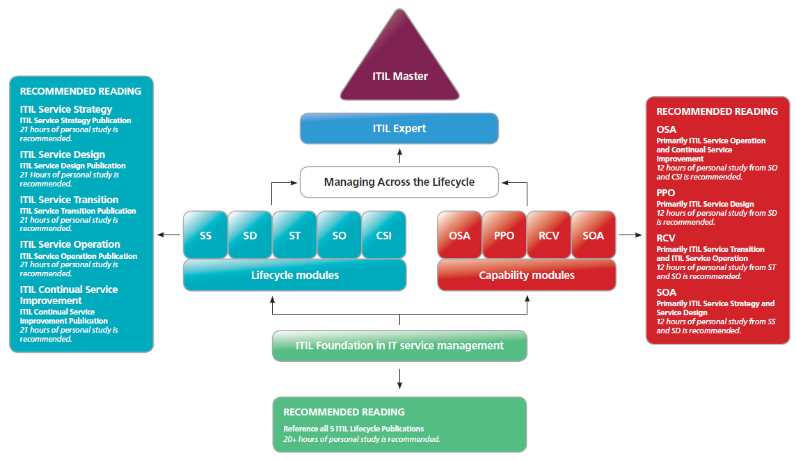
Introduction to ITIL V3
The ITIL Recommended Reading List
Source: http://www.itil-officialsite.com/

Slide 37
Introduction to ITIL V3
ITIL priSM Overview
The priSM Institute® owns and manages the professional credentialing program for IT Service Management (ITSM) professionals. The program defines a measurable framework based on one's achievements in practical application, professional contributions, and education. priSM® defines a structured path for continuing professional growth while maintaining a registry for professionals to track and reference their continued good standing.
- Student = SSM
    - Associate = ASM
    - Professional = PSM
    - Distinguished Professional = DPSM
    - Fellow = FSM
To find out more about The priSM Institute® and the credentialing scheme, go to http://www.theprisminstitute.org/Global_priSM_I/priSM_Public_Document_Library_files/1955_prisM_Handbook_v7.2.pdf
Source: www.prisminstitute.org

Slide 38
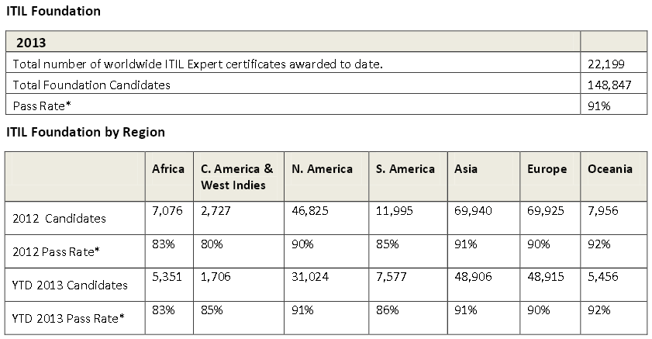
Introduction to ITIL V3
The July 2013 ITIL Certification Exam Pass Rates
Source: www.plexent.com

Slide 39
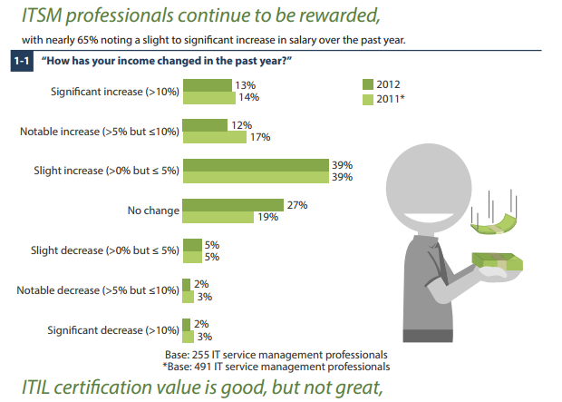
Introduction to ITIL V3
Value of ITSM Certifications
Source: Forrester Research Inc.

Slide 40
Benefits
Slide 40

Slide 41
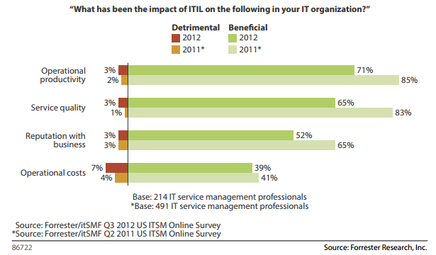
Introduction to ITIL V3
ITIL Impact to an Organization

Slide 42
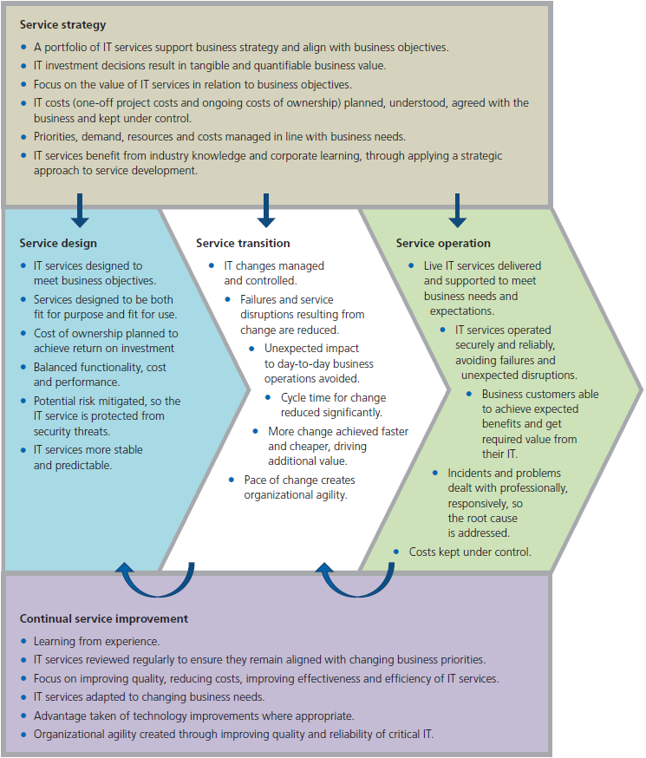
Introduction to ITIL V3
The Benefits of using ITIL
A medium-sized UK based - IT service organization invested $4m in a two-year program to improve its IT service management. It recouped the investment within the first year, and achieved annual savings of $5.4m mainly through rationalizing unused and under-used resources (people, software licenses, IT hardware etc).
Source: OGC Executive Briefing Benefits of ITIL

Slide 43
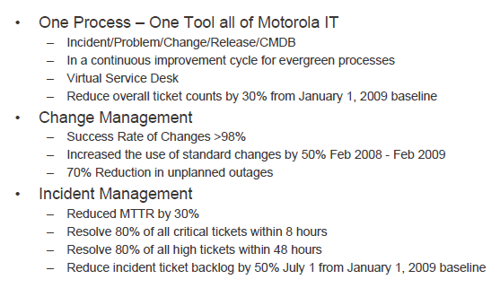
Introduction to ITIL V3
Sample Results from Using ITIL
Source: 2009 Fusion Conference Slides

Slide 44
Introduction to ITIL V3
The Criticisms of ITIL
ITIL has been criticized on several fronts, including:
The books are not affordable for non-commercial users (~ $600 USD)
Implementation and accreditation requires specific training
The training requires a significant time commitment
ITIL lacks the appropriate focus on “Digital Asset Management” (i.e. Data) look at BiSL
The ITIL framework is not prescriptive which requires access to people with prior experience. The Microsoft Operations Frameworks (MOF) attempts to resolve this
Rob England (also known as "IT Skeptic") has criticized the protected and proprietary nature of ITIL. He urges the publisher, Cabinet Office, to release ITIL under the Open Government License (OGL).
While ITIL addresses in depth the various aspects of service management, it does not address enterprise architecture in such depth. Many of the shortcomings in the implementation of ITIL do not necessarily come about because of flaws in the design or implementation of the service management aspects of the business, but rather the wider architectural framework in which the business is situated. Because of its primary focus on service management, ITIL has limited utility in managing poorly designed enterprise architectures, or how to feed back into the design of the enterprise architecture.
Source: www.wikipedia.com

Slide 45
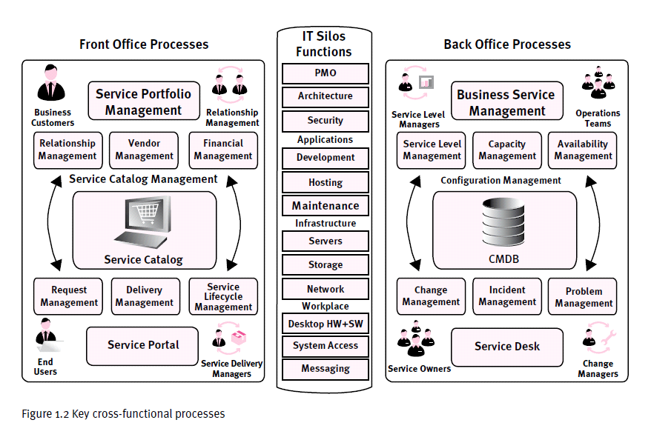
Introduction to ITIL V3
Service Architecture Model
Source: Defining IT Success thru the Service Catalog – Pink Elephant

Slide 46

Introduction to ITIL V3
Recommended Reading List
http://www.best-management-practice.com/Online-Shop/IT-Service-Management-ITIL/ITIL-2007-Edition/The-Introduction-to-the-ITIL-Service-Lifecycle/?DI=582435 ($80 MSRP, available for less than $20)
http://www.best-management-practice.com/gempdf/itsmf_an_introductory_overview_of_itil_v3.pdf
http://www.mysarir.com/wp-content/uploads/Books/ITIL_V3_SERVICE_IMPROVEMENT.pdf (2007 Edition)
http://www.itsmwatch.com/img/VisOpsChapter1.pdf
http://blog.simplilearn.com/it-service-management/defining-requirements-service-v-model-approach-itil-v3
http://www.pinkelephant.com/Products/PinkPUBLICATIONS/PinkBOOKS.htm
http://www.kotterinternational.com/ResourceItemView?MediaID=f1244856-92cf-42d9-8bff-d30dfd0d79b4

Slide 47
Introduction to ITIL V3
Useful Links
http://www.itsmfusa.org/
https://itsmfusa.site-ym.com/group/Chicago
https://itsmfusa.site-ym.com/group/Heartland
http://www.youtube.com/watch?v=M9_0_BkqwzM
http://www.itil-officialsite.com
http://www.itsmfi.org/
http://www.plexent.com/
http://www.pinkelephant.com/
http://online.pinkelephant.com/PinkEducationeITILOverview.htm
http://www.itskeptic.org

Slide 48
Introduction to ITIL V3
Trademarks & Statements
ITIL® is a Registered Trade Mark of the Office of Government Commerce in the United Kingdom and other countries
The Swirl logo™ is a Trade Mark of the Office of Government Commerce
The OGC logo® is a Registered Trade Mark of the Office of Government Commerce in the United Kingdom

Slide 49
Other Frameworks

Slide 50
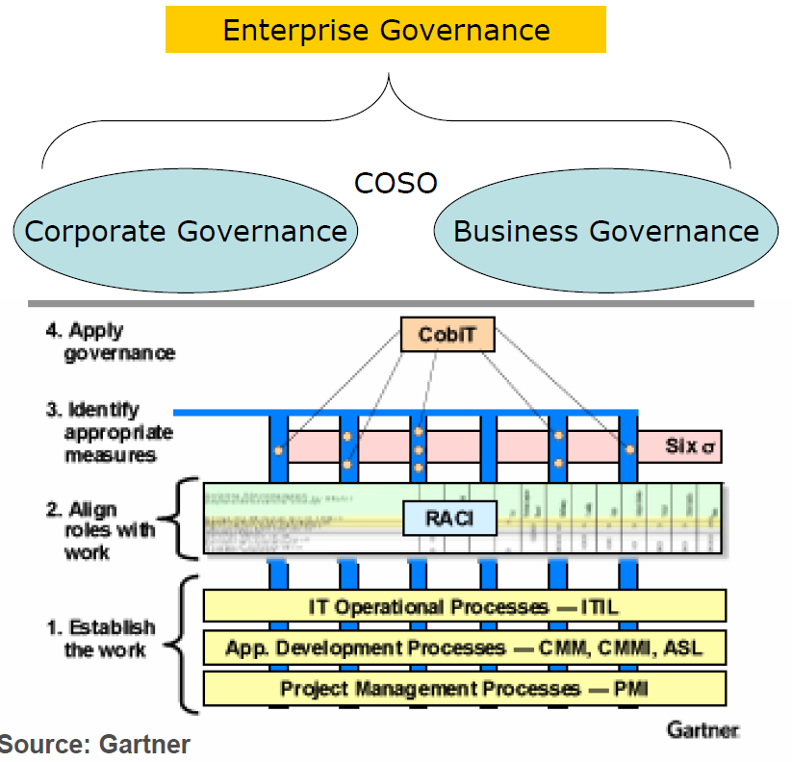
Introduction to ITIL V3
Putting it All Together
ISO 20K & ISO 27002
eSCM-CL & eSCM-SP
MOF
Source: Gartner with additions from RY

Slide 51
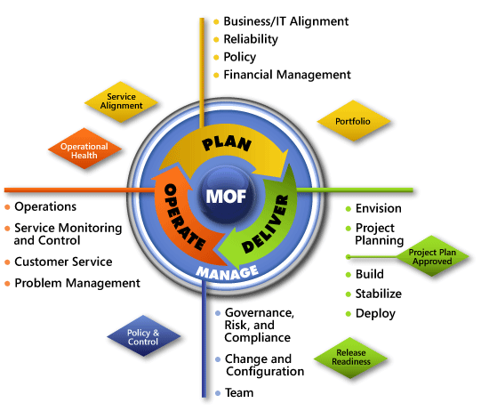
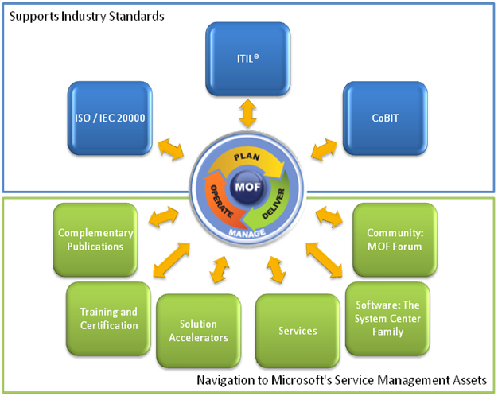
Introduction to ITIL V3
ITIL & MOF relationships
The Microsoft® Operations Framework (MOF) provides guidance on how to plan, deploy, and maintain IT operational processes in support of mission-critical service solutions, based on proven industry experience as published in the IT Infrastructure Library (ITIL).
Change Mgmt
Mind Map:
Getting Started with MOF 4.0 an Implementation Guide: http://technet.microsoft.com/en-us/library/cc506049.aspx
Source: Microsoft Technet

Slide 52
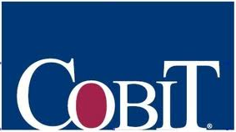
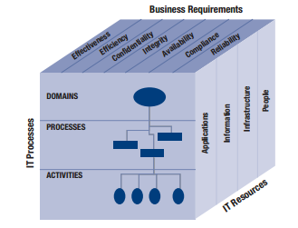
Introduction to ITIL V3
What is COBIT?
COBIT® stands for ‘Control Objectives for Information and related Technology’ It is a governance and control framework with guidance for IT controls. Its guidance enables an enterprise to implement effective governance over IT that is pervasive and intrinsic throughout the enterprise.
The overall COBIT framework can be shown graphically, with COBIT’s process model of five domains containing 37 generic processes, managing the IT resources to deliver information to the business according to business and governance requirements.
Source: ??

Slide 53

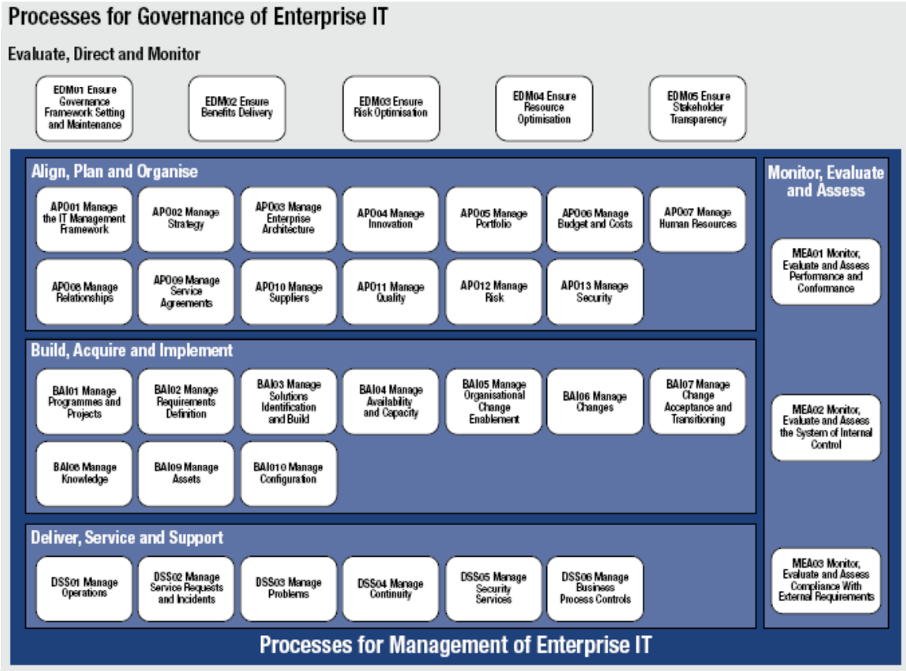
Introduction to ITIL V3
COBIT 5 Control Domains
Source: www.isaca.org

Slide 54
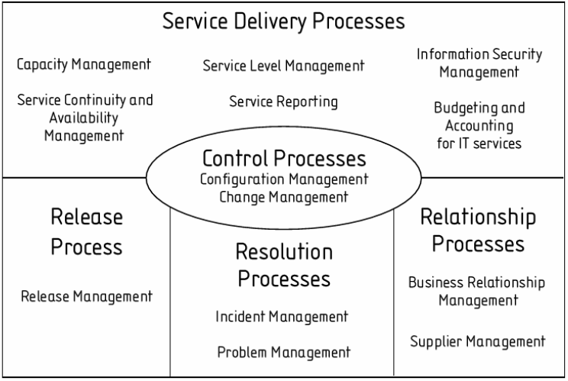
Introduction to ITIL V3
What is ISO20K?
ISO 20000 is the first service management process standard first released in 2005 & updated in 2011. It proposes a process approach to IT Service Management within an overall Plan-Do-Check-Act (PDCA) cycle. This approach enables IT organizations to establish IT Service Management processes to deliver managed services in a systematic and controlled manner an to enhance the quality of their IT services to customers.
The 2011 version of ISO20000 comprises nine sections:
1. Scope
2. Normative references
3. Terms and definitions
4. Service mgmt system general requirements
5. Design and transition of new or changed services
6. Service delivery processes
7. Relationship processes
8. Resolution processes
9. Control processes
Source: Wikipedia

Slide 55
Introduction to ITIL V3
ITIL and ISO Standards
ISO/IEC 20000 is the international standard for IT service management, which was developed based upon ITIL processes.
Adopting ITIL practices can help organizations achieve the ISO/IEC 20000 standard and provide evidence that they are practicing good IT service management.
ITIL also aligns with other ISO standards such as ISO/IEC 27002, the international standard for information security
Source: Wikipedia

Slide 56
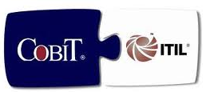
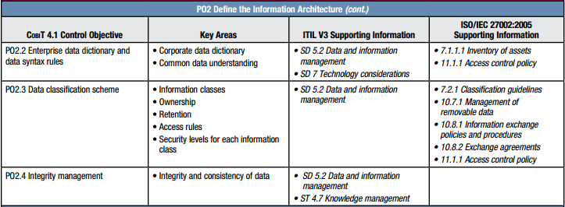
Introduction to ITIL V3
ITILV3 , COBIT & ISO27002 relationship Mapping
Source: IT Governance Institute

Slide 57

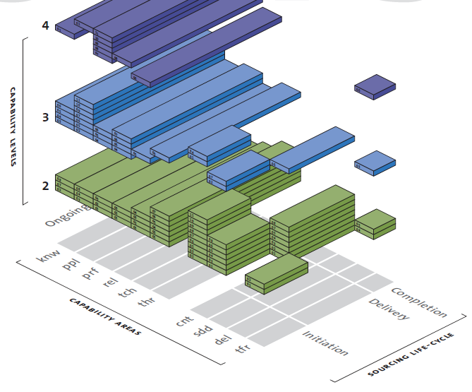
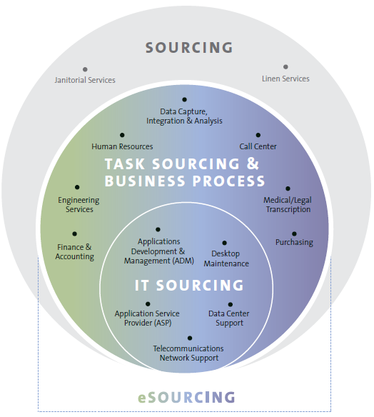
Introduction to ITIL V3
ITIL & e-SCM relationships
IT-enabled sourcing, or eSourcing, uses information technology as a key component of service delivery, or as an enabler for delivering services. Often provided remotely eSourcing services range from routine and non-critical tasks that are resource intensive and operational in nature to strategic processes that directly impact revenues.
Source: www.itsqc.org

Slide 58
Introduction to ITIL V3
What is COSO?
Committee of Sponsoring Organizations (COSO)
  Formed in 1985
  Result of the National Commission on Fraudulent Financial Reporting
  Practices for public companies to prevent false reporting
The COSO framework is a set of internal control components with the following goals:
  Effectiveness and efficiency of operations
  Reliability of financial reporting
  Compliance with applicable laws and regulations
Control framework components:
  Control environnent – discipline and structure
  Risk assessment – economic, industry, operational
  Control Activities – approval, reconciliation, separation of duties
  Information and communication
  Monitoring
Source: 2010 Fusion Conference Slides

Slide 59
Questions?

